Slide 1
Spin echo Pulse sequence Spin echo principle
V.G.Wimalasena
Principal
School of Radiography

Slide 2
Introduction
This is the basic pulse sequence in MRI
It is designed to obtain a high MR signal by converting the decay signal to a growing signal (an echo of the decay signal)
It uses , first, 90⁰ RF pulse and then a 180⁰ RF pulse before obtaining the MR signal

Slide 3
Basic data collection procedure
Slice selection
Gradient selection
RF band width selection
Pulse sequence selection
Phase encoding selection
Done by appropriate gradient selection
Frequency encoding selection
Done by appropriate gradient selection
Application & data collection

Slide 4
Demonstration of Frequency Encoding & Phase Encoding
Number of Pulse repetitions (TR steps) is decided by the number of phase encoding steps of the rows in the matrix

Slide 5
The need of 180⁰ RF pulse
To repahse the dephasing nuclei to get more data samples from the MR signal
Fast
Fast
Nuclei rephasing after inversion
Nuclei dephasing after removal of 90 pulse
Slow
Slow
Inversion by 180 pulse

Slide 6
Result of 180⁰ pulse

Slide 7
The spin echo pulse sequence
A pulse sequence that uses a 90⁰ excitation pulse first and then a 180⁰ RF pulse to convert dephasing nuclei to rephasing nuclei is called a spin echo pulse sequence.
Dephasing caused by magnetic field inhomogeneities also is compensated by the 180⁰ RF pulse.
180
90
Echo

Slide 8
Spin echo procedure
It starts with a 90⁰ excitation pulse to flip the NMV into the transverse plane.
The NMV precesses in the transverse plane and T2 decay starts.
In addition to that due to the presence of magnetic field inhomogenities it increases the decay rate so T2* dephasing occurs.

Slide 9
The T2* dephasing causes the magnetic moments to dephase or ‘fan out’ in the transverse plane.
The magnetic moments are now out of phase with each other, i.e. they are at different positions on the precessional path at any given time.
The magnetic moments that slow down, form the trailing edge of the fan, and the magnetic moments that speed up, form the leading edge of the fan
A 180⁰ RF pulse is then used to compensate for the dephasing
The 180⁰ RF pulse has sufficient energy to move the NMV through 180⁰

Slide 10
The 180⁰ RF pulse flips these individual magnetic moments through 180⁰.
They are still in the transverse plane, but now the magnetic moments that formed the trailing edge before the 180⁰ pulse, form the leading edge.
Conversely, the magnetic moments that formed the leading edge prior to the 180⁰ pulse, now form the trailing edge.
The direction of prescession remains the same, and so the trailing edge begins to catch up with the leading edge.

Slide 11
At a specific time later, the two edges are superimposed.
The magnetic moments are now momentarily in phase because they are momentarily at the same place on the precessional path.
At this instant, there is transverse magnetization in phase , this is called a spin echo
So a high signal is induced in the coil at this moment.
In practice the signal is detected and sampled during rephasing and the dephasing that follows.
The spin echo signal now can be used to get T1 and T2 information as T2* dephasing has been reduced.

Slide 12
Spin Echo - RF Rephasing
B₀
B₀
B₀
S
F
90⁰ RF
T2* dephasing
B₀
B₀
B₀
S
Result if allowed to dephase
180⁰ RF is applied before complete dephasing occurs
F
rephasing

Slide 13
Spin Echo - RF Rephasing
B₀
B₀
B₀
S
90⁰ RF
T2* dephasing
F
Result if allowed to dephase
B₀
B₀
B₀
S
S
Result in high NMV flipped by 180⁰
F
180⁰ RF is applied before complete dephasing occurs
F
rephasing

Slide 14
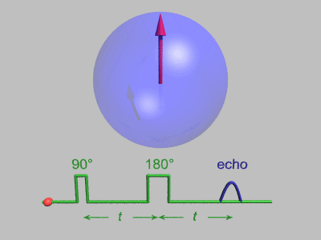
http://mriquestions.com/uploads/3/4/5/7/34572113/1517606_orig.gif

Slide 15
Timing parameters in spin echo
TR is the time between each 90⁰ excitation pulse.
TE is the time between the 90⁰ excitation pulse and the peak of the spin echo.
The time taken to rephase after the application of 180⁰ RF pulse, equals the time the NMV took to dephase when 90⁰ RF pulse was withdrawn.
This time is called the (ζ)Tau time
The TE is therefore twice the Tau time.
TE = 2 ζ

Slide 16
Spin echo pulse sequence
180⁰ RF pulse
90⁰ RF pulse
Spin echo
ζ (Tau)
ζ (Tau)
TE
TE = 2 ζ

Slide 17
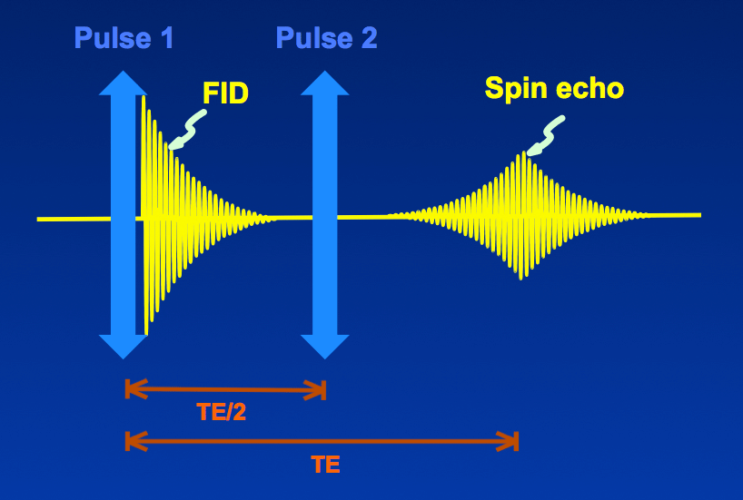
Spin Echo

Slide 18
Multiple echoes
After sampling the signal another 180 pulse can be applied to rephase the NMV and can obtain another signal
So more than one 180⁰ RF pulse can be applied after the 90⁰ excitation pulse.
Each 180⁰ pulse generates a separate spin echo that can be received by the coil and used to create an image.
One, two or four 180⁰ RF pulses can be used in spin echo, to produce one , two or four different images.

Slide 19
Using one echo (T1 weighting)
The pulse sequence can be used to produce T1 weighted images if a short TR and TE are used.
One 180⁰ RF pulse is applied after the 90⁰ excitation pulse.
Short TE ensures that only a little T2 decay has occurred, and, the differences in the T2 times of the tissues do not dominate the echo and its contrast.
Short TR ensures that fat and water vectors have not fully recovered , so the differences in their T1 times dominate the echo and its contrast.

Slide 20
Spin echo T1 weighting
180⁰ RF pulse
90⁰ RF pulse
90⁰ RF pulse
Single Spin echo
TAU
TAU
Short TE
Short TR

Slide 21
Multi-echo Spin Echo
As long as T2-relaxation has not completely destroyed the MR signal, it is possible to stimulate the system with additional 180°-pulse(s) and generate additional echo(es).
But the amplitude of each echo is progressively smaller due to T2 decay.

Slide 22
Spin echo using two echoes ( T2 weighting & Proton density )
The first spin echo is generated early by selecting a short TE. (Only a little T2 decay has occurred and so T2 differences between tissues are minimal in this echo)
The second spin echo is generated much later by selecting a long TE
A significant amount of T2 decay has now occurred, and so the differences in the T2 times of the tissues are maximized in this echo.
The TR selected is long , so that T1 differences between tissues are minimized.
The first spin echo therefore has a short TE and a long TR and is proton density weighted.
The second spin echo has a long TE and a long TR and is T2 weighted.

Slide 23
Dual echo - T2 weighting & Proton density
Long TR
180⁰
180⁰
1st spin echo proton density
90⁰
2nd spin echo T2
90⁰
1st TE (short)
2nd TE (long)

Slide 24
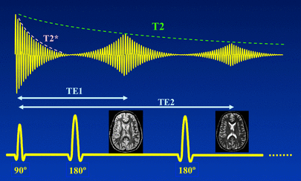
Dual-eco Spin echo

Slide 25
A few decades ago Dual-echo SE sequences like the one pictured above were a standard technique.
The first echo (at short TE) provided "spin-density" contrast while the second echo (at long TE) provided T2-weighted contrast.
Today, T2-FLAIR has largely supplanted spin-density-weighted SE images for most applications, so multi-echo SE is only occasionally used.

Slide 26
Fast (Turbo) Spin Echo (FSE)
Multi-echo SE should be distinguished from FSE where multiple 180°-pulses and echoes also follow each 90°-pulse.
The simplified FSE pulse-echo timing diagram appears below

Slide 27
Superficially this appears similar to multi-echo SE, although you may note that the echoes are not uniformly diminishing in size with increasing TE multi-echo SE as expected.
The reason the echoes look different is because in FSE different phase-encoding gradients (not shown) are being applied with each 180°-pulse.
In single echo and multi-echo SE imaging, the phase-encoding gradient is turned on only once in each TR interval. Depending on the number of echoes, in FSE imaging the phase-encoding may be applied 8, 16, 32 or more times in each TR interval.

Slide 28
Summary
A spin echo pulse sequence uses a 90⁰ excitation pulse followed by one or more 180⁰ rephasing pulses to generate one or more spin echoes.
Spin echo pulse sequences produce either T1, T2 or proton density weighting.
TR controls the T1 weighting.
Short TR maximizes T1 weighting
Long TR maximizes proton density weighting
TE controls the T2 weighting
Short TE minimizes T2 weighting
Long TE maximizes T2 weighting

Slide 29
Next
Gradient echo pulse sequence

