Slide 1
Introduction to Magnetic Resonance Imaging - part 2
V.G.Wimalasena
Principal
Sri Lanka School of Radiography

Slide 2
MRI Safety

Slide 3
The Superconductive Magnet
Present scanners use superconductive magnets.
The current through the coils flow without external power supply
No resistance to flow of electricity
Eearly magnets used Coils of wire surrounded by cryogen bath (Liquid Helium) at -273° C
Modern magnets use Solid Nitrogen as dry cryogen.
Magnetic field present ALL THE TIME!!!

Slide 4
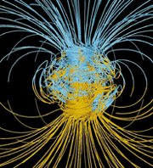
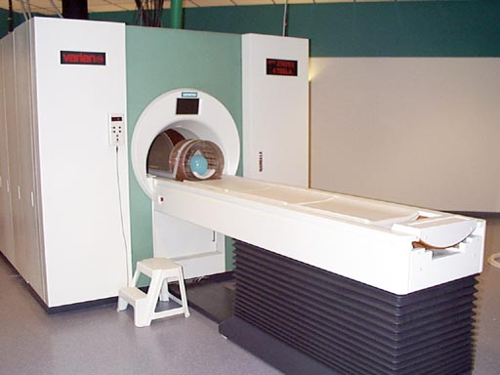
Comparison between Earth’s magentic field and The Big Magnet
Very strong
1 Tesla (T) = 10,000 Gauss
Earth’s magnetic field = 0.5 Gauss
4 Tesla = 4 x 10,000 ÷ 0.5 = 80,000X Earth’s magnetic field
Continuously on
Main field = B₀
Robarts Research Institute 4T
B₀
x 80,000 =
Source: www.spacedaily.com

Slide 5
Refrigerator door magnet - 150-250 G
10,000 Gauss = 1Tesla
MRI - 0.2T - 1.5T, 3 T, 4T
∼ 100x stronger that fridge magnet

Slide 6
The strong magnetic field of the magnet can turn the following into dangerous projectiles:
wheelchairs
oxygen tanks
I.V. poles
I.D. tags
keys
coins
scissors
trauma boards
safety pins

Slide 7
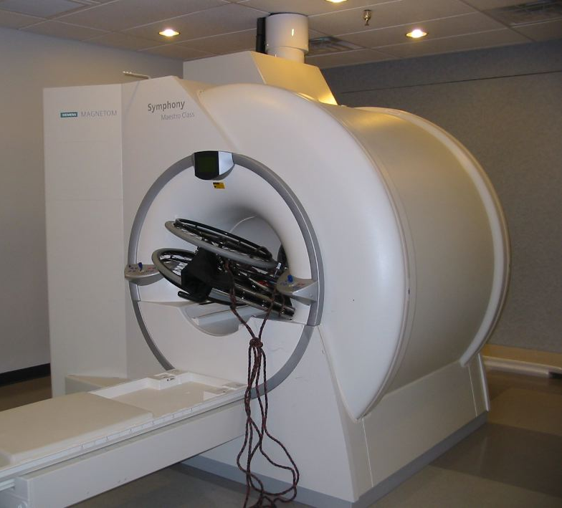
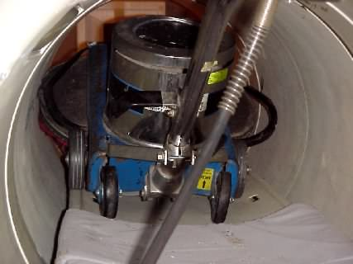
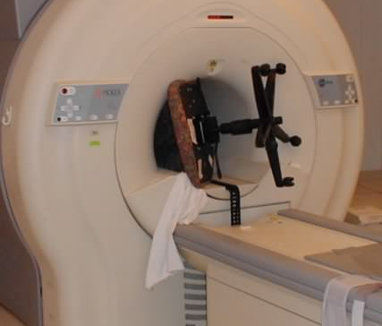
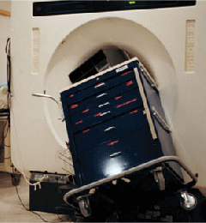
Magnet Safety
The whopping strength of the magnet makes safety essential. Things fly – Even big things!

Slide 8
Subject Safety
Anyone going near the magnet – patients, staff and visitors – must be thoroughly screened:
Patients must have no metal in their bodies:
pacemaker
aneurysm clips
metal implants (e.g., cochlear implants)
interuterine devices (IUDs)
some dental work (fillings okay)

Slide 9
Patients must remove metal from their bodies
jewellery, watch, piercings
coins, etc.
wallet
any metal that may distort the field (e.g., underwire bra)
Patients must be given ear plugs (acoustic noise can reach 120 dB)

Slide 10
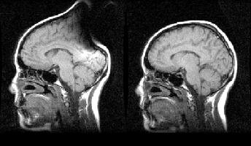
Patient wearing some metallic objects may produce image artefacts
This subject was wearing a hair band with a ~2 mm copper clamp. Left: with hair band. Right: without.
Source: Jorge Jovicich

Slide 11
The changing magnetic fields can do damage to:
Monitoring equipment
Infusion pumps
Credit cards
Cellular telephones
Any electronic device

Slide 12
The following are (usually*) okay:
Gold
Silver
Digital watches
Eyeglass frames
Snaps/zippers fastened to clothing
Dental work

Slide 13
APPLICATIONS

Slide 14
Advantages of MRI
Superior soft tissue contrast resolution - excellent pathological discrimination
No ionizing radiation
Direct multi-planar imaging (transverse, coronal, sagittal, any oblique)
Non-invasive - vascular studies can be performed without contrast

Slide 15
Disadvantages of MRI
Expensive
Long scan times
Audible noise (65-115dB)
Isolation of patient (claustrophobia, difficulty in monitoring of ill patients)
Exclusion of patients with pacemakers and certain implants

Slide 16
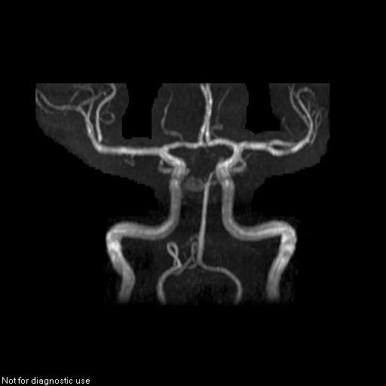
Angiographic techniques
Circle of Willis angiograms without any contrast

Slide 17
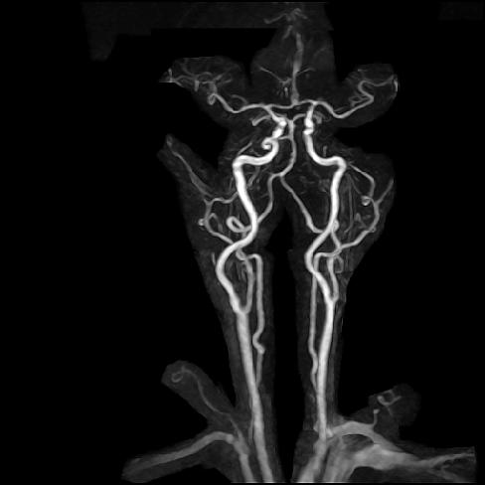
Angiographic techniques
Studies can be performed with or using MR sensitive contrast

Slide 18
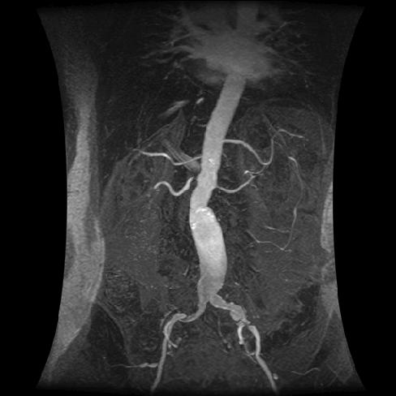
Renal MRA

Slide 19
Contrast media – Gadolinium compounds
USEFUL FOR DETECTION OF:
Tumours pre- and post-operative
Infection
Inflammation
Post-traumatic lesions
Post-operative changes
MRA’s

Slide 20
BRAIN
Hemorrhage (stages of)
Demyelinating disorders (M.S.)
Infectious processes (encephalitis, meningitis)
Abscesses
Neoplasms
Neurofibromatosis
Trauma
Vascular disorders (AVM’s, infarcts, aneurysms)

Slide 21
BRAIN (cont’d)
Metastasis
Internal auditory canal pathology
Pituitary pathology
Hydrocephalus
Child abuse
Cranial nerve pathology
Congenital anomalies (for anatomical review)
Epilepsy (seizures in general)

Slide 22
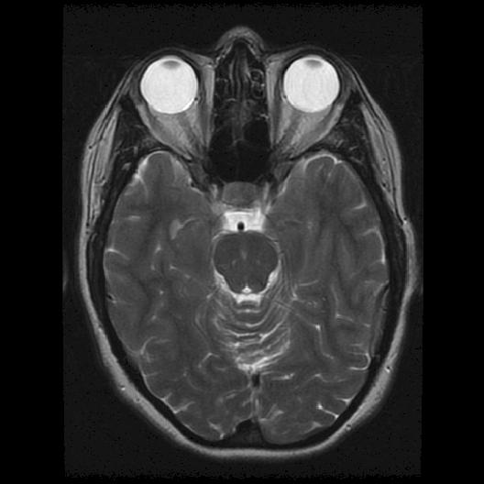
Axial T2 Weighted Brain

Slide 23
SPINE
Radiculopathy
Tumours
Trauma/contusion
Syringomyelia
Metastasis
Vascular disorders
Cord edema
M.S. plaques

Slide 24
SPINE (cont’d)
Cauda equina syndrome
Tethered cord
Arachnoiditis
Marrow-replacing processes
Degenerative disc disease
Discitis
Congenital anomalies

Slide 25
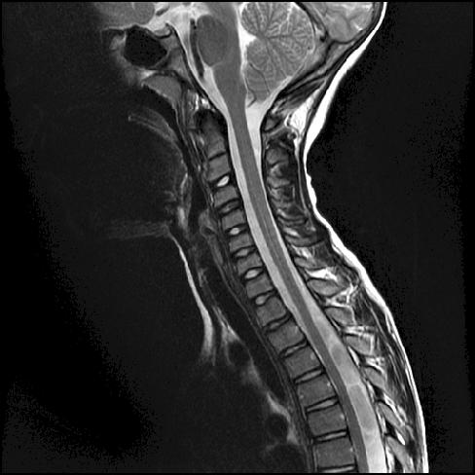
SPINE T2 Weighted Sagittal

Slide 26
Musculoskeltal (shoulder, knee, ankle, wrist, elbow, TMJ)
Meniscal pathology
Ligament/tendon injury
Muscle/nerve impingement
Avascular necrosis
Labral tears (shoulder, hip)
Chondromalacia
Inflammation (osteomyelitis)
Primary bone tumours
Soft tissue tumours

Slide 27
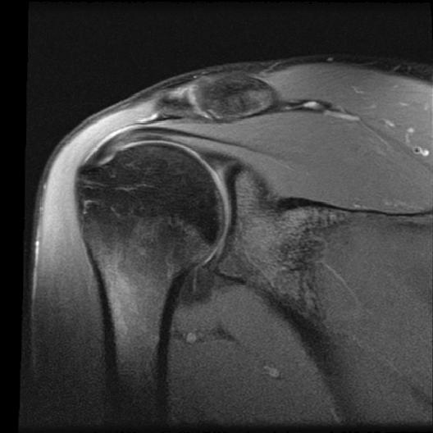
Shoulder

Slide 28
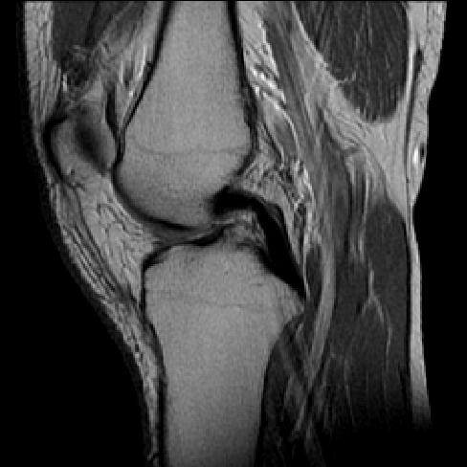
KNEE

Slide 29
Abdominal/Pelvic
Liver pathology
Kidney pathology
Renal artery MRA
Fetal abnormalities

Slide 30
Abdominal imaging
Breath-hold scans to overcome motion artifact problem
MRCP’s – Magnetic Resonance Chollidoco Pancreatograme images of the biliary and pancreatic ductal systems performed non-invasively (no contrast or endoscope!) within seconds
Fetal imaging very diagnostic

Slide 31
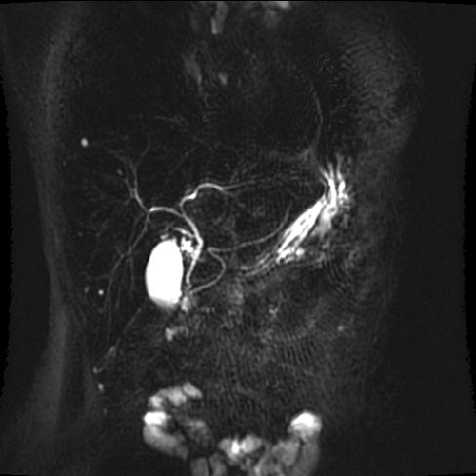
MRCP

Slide 32
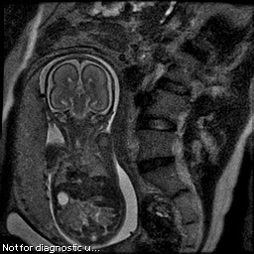
Fetal breath-hold image

Slide 33
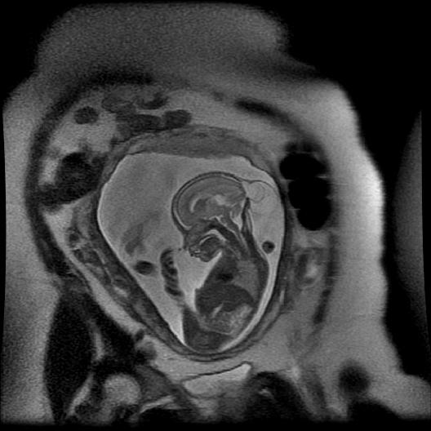
Fetal Encephalocele

Slide 34
Cardiac
Co-arctation
RV dysplasia
Cinematic studies
Measure cardiac output, stroke volume, ejection fraction

Slide 35
MR Spectroscopy (MRS)
Information obtained is in the form of a spectrum which provides the biochemical information contained within a selected voxel of tissue
Used to detect the absence or presence of a certain compound
Assists in differential diagnosis when standard clinical radiological tests fail or are too invasive

Slide 36
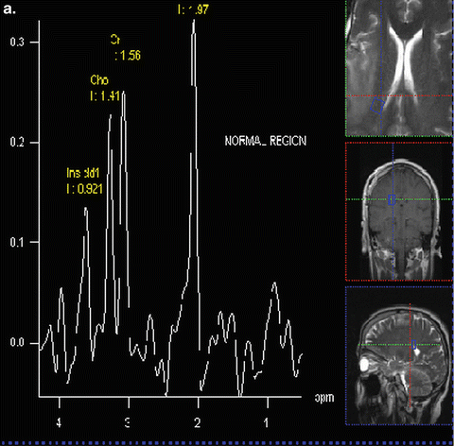
Proton MR spectra of normal brain

Slide 37
MRS Current Applications
Multiple Sclerosis
Leigh’s
Huntington’s
Parkinson’s
Alzheimer’s
Epilepsy
other dementias
metabolic disorders
Stroke
Asphyxiation or ischemic injury
Tumours and intracranial lesions
Prostate cancer
Encephalopathies
Leukodystrophies

Slide 38
Functional MRI (fMRI)
Detects changes in blood flow or metabolism associated with specific motor or sensory functions or stimuli
Performed by scanning specific areas of the brain/spine while:
a) the subject performs a certain motor task or
b) exposing the subject to certain external/internal stimuli

Slide 39
fMRI cont’d
Subjects are scanned at rest and then during exercise or exposure to various stimuli
The two conditions are subtracted to reveal areas of brain activation
Areas of activation will have increased levels of blood flow and are therefore detectable

Slide 40
fMRI cont’d
Mapping of the brain’s motor and sensory areas
Delineating primary cortical areas prior to surgery on patients with tumours (to avoid paralysis when operating on tumours in dangerous locations)
Assessment of brain function following injury

Slide 41
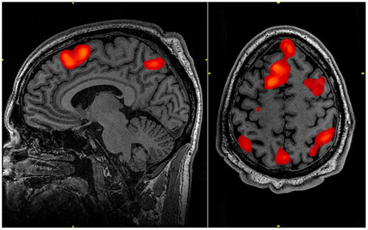
Functional MRI technology to detect changes in cerebral blood flow. When blood flow to a particular brain region is increased, it suggests brain activity in this area has increased. Thus, fMRI can allow investigators to see what areas of the brain are active when an individual engages in a particular task.

Slide 42
MANY OTHER WORKS IN PROGRESS…

Slide 43
END

