Slide 1
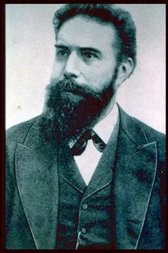
Important milestones of medical imaging
Evolution after discovery of X-rays

Slide 2
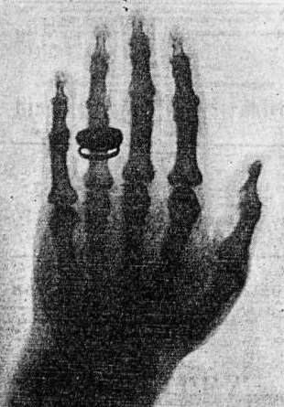
X-rays discovered by German physicist Wilhelm Conrad Roentgen. He also produced the first x-ray picture of the body (his wife's hand) in 1895.
1895

Slide 3
Chest x-ray widespread use of the chest x-ray made early detection of tuberculosis (which was the most common cause of death)
1900

Slide 4
X-ray IV contrast medium First contrast filled image of the renal system (kidneys).
1906

Slide 5
Barium sulfate Introduction as contrast agent for gastro-intestinal diagnosis.
1910

Slide 6
Theory of Radioactivity published by Marie Curie and investigation of radiation for patient therapy (e.g. treatment of cancer).
1910/1912

Slide 7
Founded Society of Radiographers UK
1920

Slide 8
Radiographic imaging of the gallbladder, bile duct and blood vessels for the first time.
1924

Slide 9
Sri Lanka Start of Radiological services in Sri Lanka Dr. H.O.Goonawardane – first Radiologist
1925

Slide 10
First trained Radiographers in Sri Lanka appointed Mr. M.L.B.J. Caspersz & Mr. J.A.N. Fernandopulle
1928

Slide 11
Cardiac catheterization first performed by Forssmann on himself.
1929

Slide 12
Publication “Positioning in radiography” by K.C.Clark - UK
1939

Slide 13
Coronary artery imaging Visualization of (blood vessels that feed the heart).
1945

Slide 14
In Sri Lanka Founded the Government X-ray Technical Officers’ Association Publication of the journal “Ceylon Radiographer”
1948

Slide 15
Publication “Atlas of Radiographic positions” by Vinita Merill - America
1949

Slide 16
Nuclear Medicine applied in imaging the kidneys, heart, and skeletal system.
1950

Slide 17
X-ray Image Intensifier-Television units To allow dynamic x-ray imaging of moving structures.
1955

Slide 18
OPG Panoramic x-ray images of the entire jaw and teeth.
1955

Slide 19
Inauguration of Sri Lanka School of Radiography by Mr. Jaundrell Thompson B.Sc., F.S.R
1957

Slide 20
Ultrasound imaging using high frequency sound waves to look at the abdomen and kidneys, fetal baby, carotid blood vessels and heart.
1960

Slide 21
X-ray mammography finds widespread application in imaging the breasts.
1970

Slide 22
Computed Tomography (CT) scanning invented by British engineer Godfrey Hounsfield of EMI Laboratories, England, and South African born physicist Allan Cormack of Tufts University, Massachusetts.
1972

Slide 23
In Sri Lanka Founded the Society of Radiographers – Sri Lanka
1975

Slide 24
DSA Digital subtraction Angiography
1977

Slide 25
Magnetic Resonance Imaging (MRI) of the brain was first done on a clinical patient. MRI was developed by Paul Lauterbur and scientists at Thorn-EMI Laboratories, England, and Nottingham University, England.
1980

Slide 26
Radiography training around the world changed from 2- year diplomas to 3-yearhigher diplomas and then to 3-4 year bachelors' degrees

Slide 27
CR first Computed radiography system introduced
1981

Slide 28
3-Dimensional image processing using digital computers and CT or MR data, three dimensional images of bones and organs were first made.
1984

Slide 29
Positron Emission Tomography (PET) Clinical scanning developed by scientists at the University of California
1985

Slide 30
PACS Clinical Networks were first implemented to allow digital diagnostic images to be shared between physicians via computer network, allowing a doctor in Boston to review a CT examination from a patient in Beijing, China
1985

Slide 31
Spiral CT allows fast volume scanning of an entire organ during a single, short patient breath hold of 20 to 30 seconds. Spiral CT had caused a renaissance in CT and lead the way to significant developments like CT Angiography.
1989

Slide 32
MR Angiography developed and clinically available to allow non-invasive imaging of the blood vessels without radiation or contrast injection.
1989

Slide 33
Echo Planar MR Imaging (EPI) Developed and clinically available to allow MR systems to provide early detection of acute stroke. EPI also makes possible functional imaging, for instance of brain activity allowing doctors to investigate the function of different centers of the mind.
1993

Slide 34
Open MRI Developed to allow MR scanning of severely claustrophobic or obese patients who could not tolerate conventional MR imaging in a close bore system.
1993

Slide 35
PET/CT scanner Invented by Dr. Ron Nutt and Dr. David Townsend The first generation of PET/CT scanners included a single slice spiral CT integrated with a PET camera which utilized BGO detectors. SPECT/CT also was introduced
2000

Slide 36
Radiotherapy
Many advancements have taken place.
(This will be dealt with in the lecture by a Medical Physicist today)

Slide 37
In Sri Lanka Inauguration of First BSc. Radiography programme at University of Peradeniya
2005

Slide 38
In sri Lanka first ever BSc. graduate radiographers pass out
2011

Slide 39
End ? What is awaiting TO BE DONE ?

Slide 40
The greatest tribute we can pay to roentgen is to provide a better service to the sick and the needy. UPGRADING THE TECHNOLOGY ALONE CANNOT ACHIEVE THAT UNLESS THE COMPETENCY OF THE USER IS OF HIGH STANDARD

Slide 41
In almost all the countries radiography courses today are University degree courses. This has become necessary to meet the advancement in technology and requirement in accurate diagnosis and therapy.

Slide 42
It is necessary to make avenues to advance our knowledge in keeping with international levels and standards. An external degree programme is an appropriate and practical solution and is the need of the hour.

Slide 43
Thank you !

